Slide 1


Team : 7137rishi
PS : Enhancing talent Engagement and hiring efficiency
Link to working Repository (under development)*

Slide 2

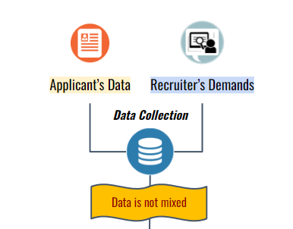
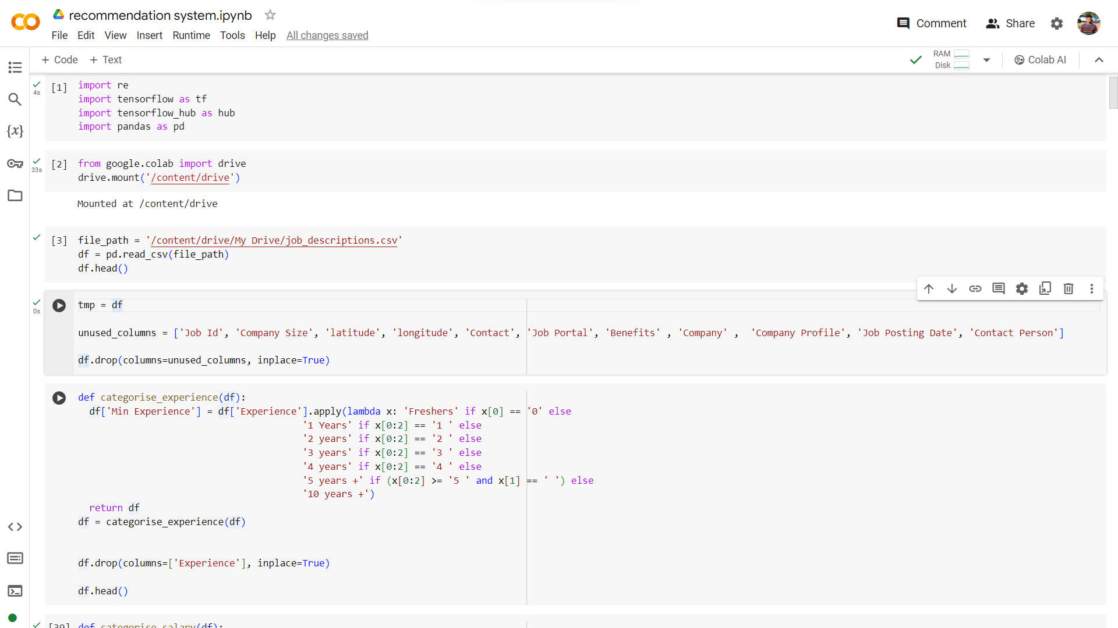
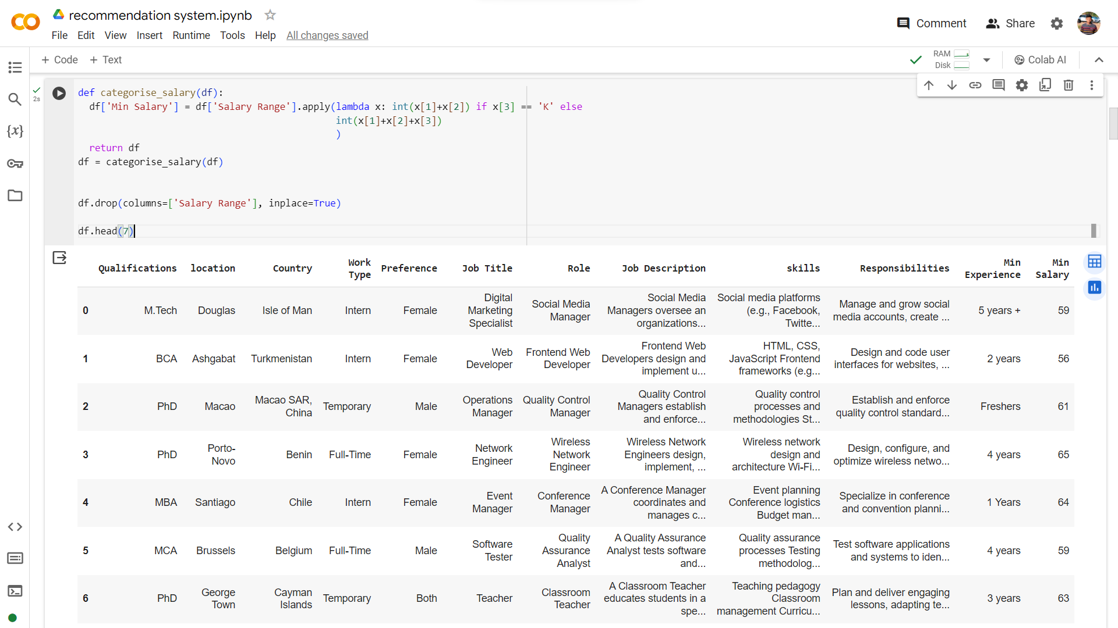
Data Pipelining
In this phase, I began by feeding our model with job descriptions (must be taken from Unstop for real model*) using a sample dataset, job_description.csv, obtained online.
Afterward, I analyzed the data by plotting graphs to uncover insights. I then simplified the dataset by removing unnecessary information and manually categorizing the data using maps and functions to align with project goals.
Notes:
1. Recommendation system -
Collect Data From Both sides
Sentiment analysis on JOB Description.(through NLP)
#method 1 - content based filtering
Classifiy the job description and applicants data using: (DIVISION IN DIMENSIONS by Vectorisisations)
Word2Vec Algorithm: learning word embeddings, which are dense vector representations of words
TF - IDF : used to Iigh a keyword in any content and assign importance
Cosine Similarity : measures the similarity betIen two vectors by calculating the cosine of the angle betIen them.
#method 2
Collaborative filtering method.
Matrix Factorisation ( predict likelihood of users)
<improve data accuracy> - using Transfer learning (from LLMs)
it is called fine tuning
will enhance the efficiency of data drastically
LLM to be used 4J
2. EDA ( Exploratory data analysis )
Graph
trends analysis
This analysis will give us :-
Trends, Pattern,
If this data is shown Customers - (Job applicant and Hiring Manager)
This will help in Customer Engagement.
I will use seamless UI for this.
3. System Scales.( SCALING )
to Efficienty manage the increase in data I can distribute the task using MICROSERCICES.
Recommendation System || data analysis || Sentiment Analysis
Distributed scaling systems - Kaska ,Load Balancers. <-- system design
4. Deployment (Docker and Kubernetes) - so that application run in any environment

Slide 3
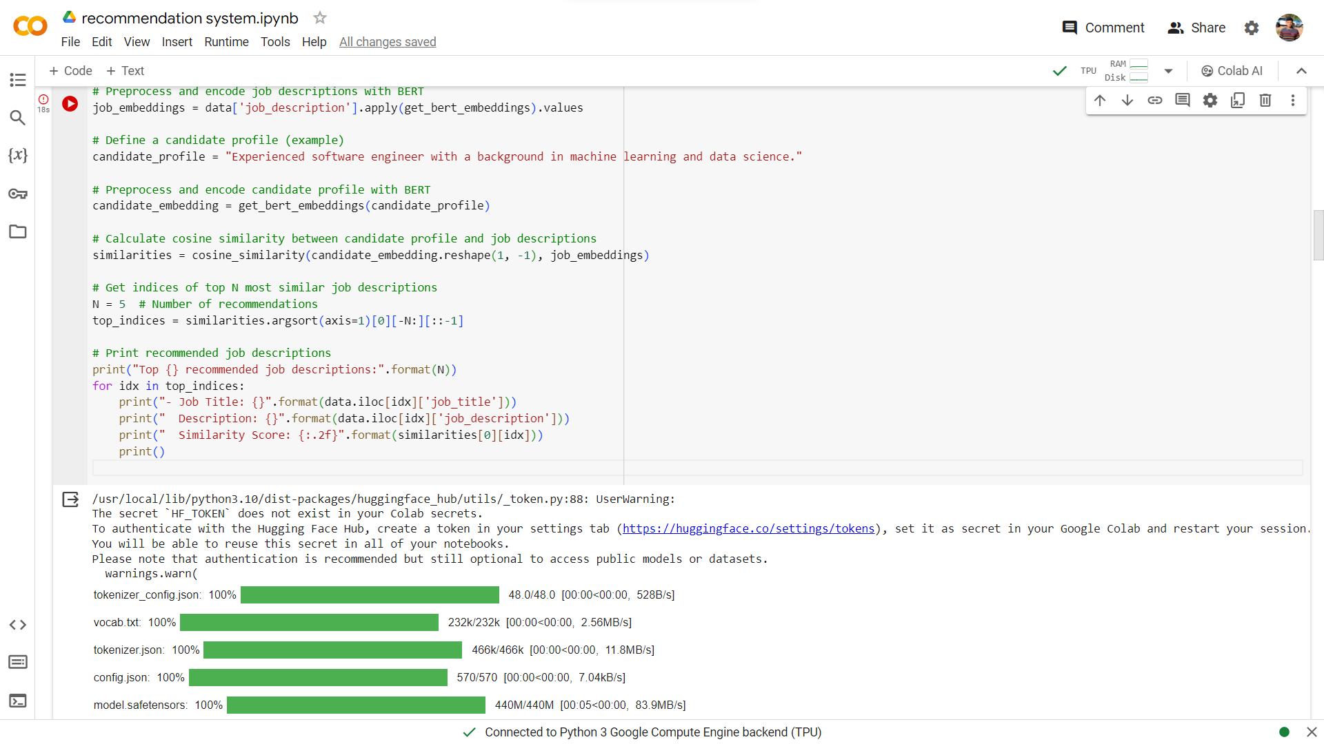
Fine-Tuning model using our datasets.
In this subsequent phase, I proceeded by loading a pre-trained BERT model and tokenizer. I then defined a function to encode text using BERT and obtain embeddings, which capture contextual information from the input text.
Next, I loaded the hiring database and preprocessed the job descriptions using BERT encoding. Leveraging this encoded data, I identified the top 5 job recommendations tailored to the candidate's profile. This process harnesses the power of BERT embeddings to match candidate skills with job requirements effectively.
BERT is a Transformer based model which is state of the art model and is highly capable of understanding text.
What is transformer model ?
Encoders:
Words get turned into numbers.
Tells the model the order of words.
Decoders:
Starting point for the output is set.
Model figures out what to say next based on context.
Notes:
1. Recommendation system -
Collect Data From Both sides
Sentiment analysis on JOB Description.(through NLP)
#method 1 - content based filtering
Classifiy the job description and applicants data using: (DIVISION IN DIMENSIONS by Vectorisisations)
Word2Vec Algorithm: learning word embeddings, which are dense vector representations of words
TF - IDF : used to Iigh a keyword in any content and assign importance
Cosine Similarity : measures the similarity betIen two vectors by calculating the cosine of the angle betIen them.
#method 2
Collaborative filtering method.
Matrix Factorisation ( predict likelihood of users)
<improve data accuracy> - using Transfer learning (from LLMs)
it is called fine tuning
will enhance the efficiency of data drastically
LLM to be used 4J
2. EDA ( Exploratory data analysis )
Graph
trends analysis
This analysis will give us :-
Trends, Pattern,
If this data is shown Customers - (Job applicant and Hiring Manager)
This will help in Customer Engagement.
I will use seamless UI for this.
3. System Scales.( SCALING )
to Efficienty manage the increase in data I can distribute the task using MICROSERCICES.
Recommendation System || data analysis || Sentiment Analysis
Distributed scaling systems - Kaska ,Load Balancers. <-- system design
4. Deployment (Docker and Kubernetes) - so that application run in any environment

Slide 4


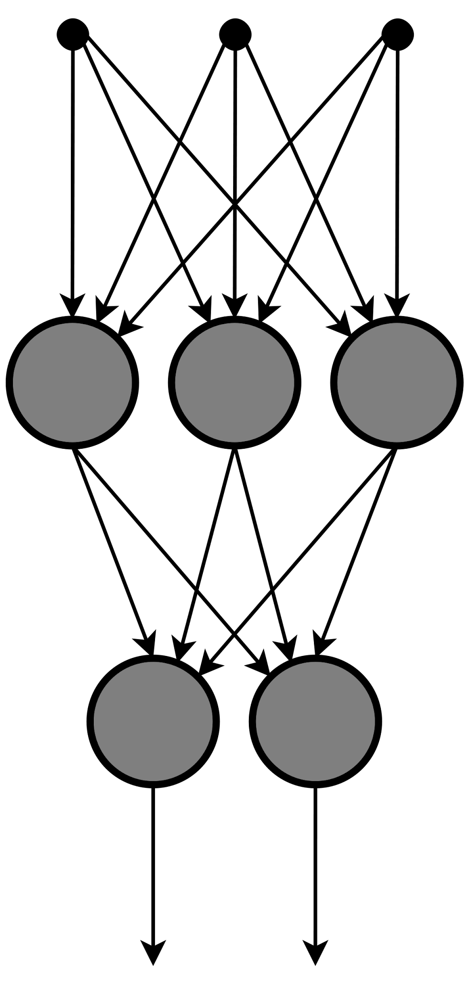



Cosine Similarity for recommendations scores calculations
I'll employ Cosine Similarity to gauge the likeness between the candidate profile and job descriptions. Subsequently, I'll sort the results by similarity, presenting the top 5 matches to the user in descending order. This method ensures that the most pertinent job opportunities are prioritized, enhancing the user's job search experience.
Data Processing
Sentiment
Analysis
WORDS
Word2Vec Algorithm
Encoders in GPT and BERT model have these inbuilt
NLP
TF-IDF Algorithm
-IDF
Cosine Similarity Algorithm
Notes:
1. Recommendation system -
Collect Data From Both sides
Sentiment analysis on JOB Description.(through NLP)
#method 1 - content based filtering
Classifiy the job description and applicants data using: (DIVISION IN DIMENSIONS by Vectorisisations)
Word2Vec Algorithm: learning word embeddings, which are dense vector representations of words
TF - IDF : used to Iigh a keyword in any content and assign importance
Cosine Similarity : measures the similarity betIen two vectors by calculating the cosine of the angle betIen them.
#method 2
Collaborative filtering method.
Matrix Factorisation ( predict likelihood of users)
<improve data accuracy> - using Transfer learning (from LLMs)
it is called fine tuning
will enhance the efficiency of data drastically
LLM to be used 4J
2. EDA ( Exploratory data analysis )
Graph
trends analysis
This analysis will give us :-
Trends, Pattern,
If this data is shown Customers - (Job applicant and Hiring Manager)
This will help in Customer Engagement.
I will use seamless UI for this.
3. System Scales.( SCALING )
to Efficienty manage the increase in data I can distribute the task using MICROSERCICES.
Recommendation System || data analysis || Sentiment Analysis
Distributed scaling systems - Kaska ,Load Balancers. <-- system design
4. Deployment (Docker and Kubernetes) - so that application run in any environment

Slide 5
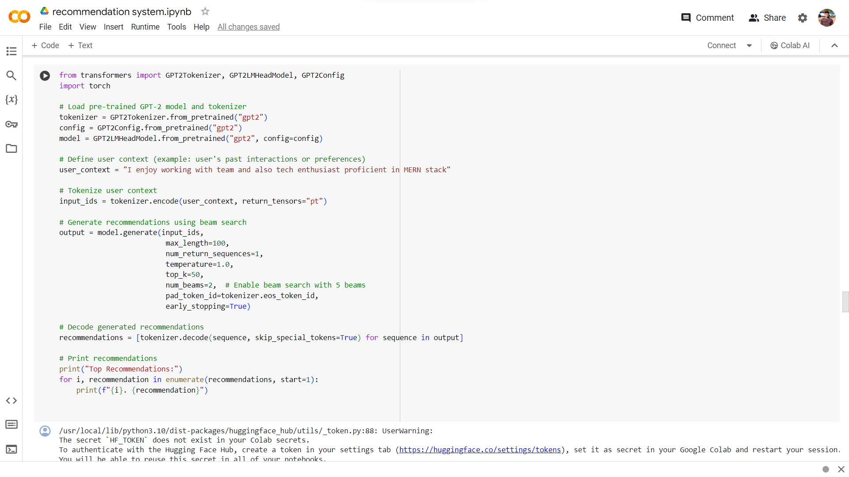
Resume Text Augmentation using GPT to increase Hiring Efficiency
Our model offers the ability to enhance resumes by analyzing each sentence in the candidate profile, augmenting the text to better align with job descriptions, thereby improving job matching accuracy. Applicants can select and apply these enhancements suggested by the model. Moving forward, our goal is to leverage this capability to generate improved resumes, providing better titles and enhanced content lines to enhance the overall quality and effectiveness of job applications.
Notes:
1. Recommendation system -
Collect Data From Both sides
Sentiment analysis on JOB Description.(through NLP)
#method 1 - content based filtering
Classifiy the job description and applicants data using: (DIVISION IN DIMENSIONS by Vectorisisations)
Word2Vec Algorithm: learning word embeddings, which are dense vector representations of words
TF - IDF : used to Iigh a keyword in any content and assign importance
Cosine Similarity : measures the similarity betIen two vectors by calculating the cosine of the angle betIen them.
#method 2
Collaborative filtering method.
Matrix Factorisation ( predict likelihood of users)
<improve data accuracy> - using Transfer learning (from LLMs)
it is called fine tuning
will enhance the efficiency of data drastically
LLM to be used 4J
2. EDA ( Exploratory data analysis )
Graph
trends analysis
This analysis will give us :-
Trends, Pattern,
If this data is shown Customers - (Job applicant and Hiring Manager)
This will help in Customer Engagement.
I will use seamless UI for this.
3. System Scales.( SCALING )
to Efficienty manage the increase in data I can distribute the task using MICROSERCICES.
Recommendation System || data analysis || Sentiment Analysis
Distributed scaling systems - Kaska ,Load Balancers. <-- system design
4. Deployment (Docker and Kubernetes) - so that application run in any environment

Slide 6


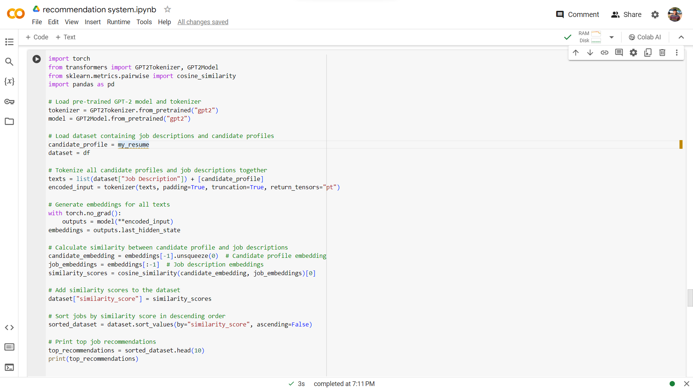
Crafting an Ensemble Model for Recommendation Systems
+
Utilizing the GPT model, a Large Language based Model trained with billions of parameters on vast datasets, offers a sophisticated approach to text processing. Its expansive neural networks and self-attention mechanism, akin to BERT, aid in text encoding.
GPT often exhibits higher accuracy compared to BERT due to its extensive training data and complex architecture. By integrating both models, I aim to achieve optimal results. This involves generating two similarity scores—one from each model—and selecting the best score to maximize accuracy and effectiveness in job matching. This combined approach capitalizes on the strengths of both models to enhance the quality of job recommendations.
Leveraging the BERT model for efficient encoding and the GPT model for effective decoding offers a comprehensive approach to text processing. By combining these strengths, I enhance accuracy, speed, and overall efficiency in our model.
Notes:
1. Recommendation system -
Collect Data From Both sides
Sentiment analysis on JOB Description.(through NLP)
#method 1 - content based filtering
Classifiy the job description and applicants data using: (DIVISION IN DIMENSIONS by Vectorisisations)
Word2Vec Algorithm: learning word embeddings, which are dense vector representations of words
TF - IDF : used to Iigh a keyword in any content and assign importance
Cosine Similarity : measures the similarity betIen two vectors by calculating the cosine of the angle betIen them.
#method 2
Collaborative filtering method.
Matrix Factorisation ( predict likelihood of users)
<improve data accuracy> - using Transfer learning (from LLMs)
it is called fine tuning
will enhance the efficiency of data drastically
LLM to be used 4J
2. EDA ( Exploratory data analysis )
Graph
trends analysis
This analysis will give us :-
Trends, Pattern,
If this data is shown Customers - (Job applicant and Hiring Manager)
This will help in Customer Engagement.
I will use seamless UI for this.
3. System Scales.( SCALING )
to Efficienty manage the increase in data I can distribute the task using MICROSERCICES.
Recommendation System || data analysis || Sentiment Analysis
Distributed scaling systems - Kaska ,Load Balancers. <-- system design
4. Deployment (Docker and Kubernetes) - so that application run in any environment

Slide 7
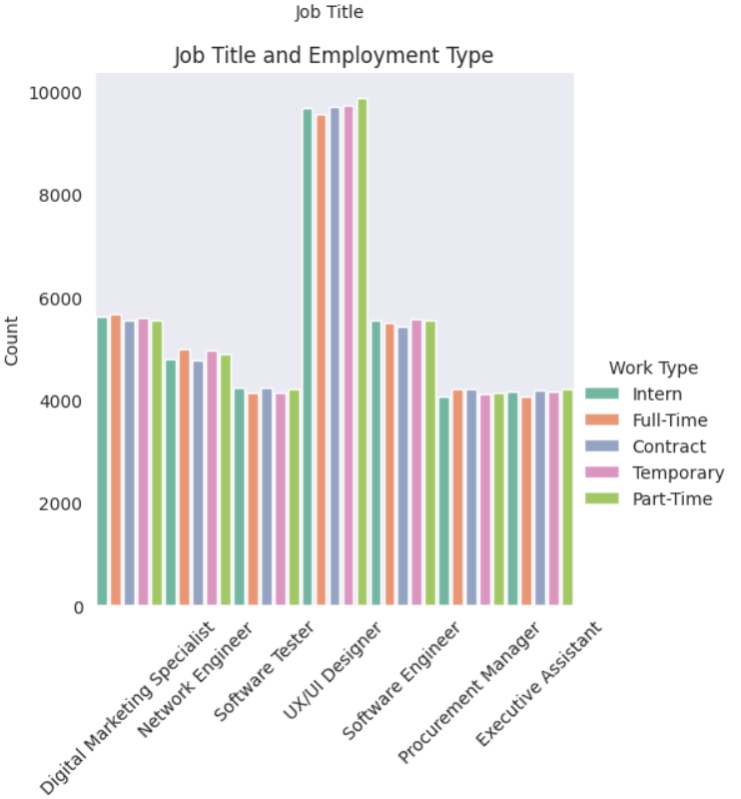
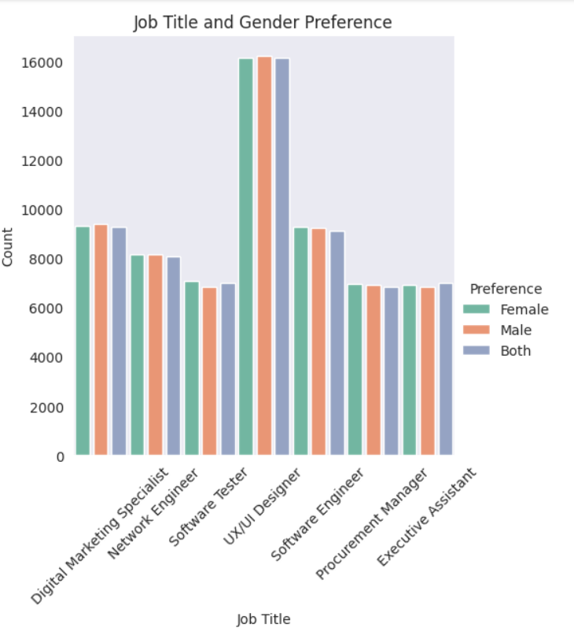
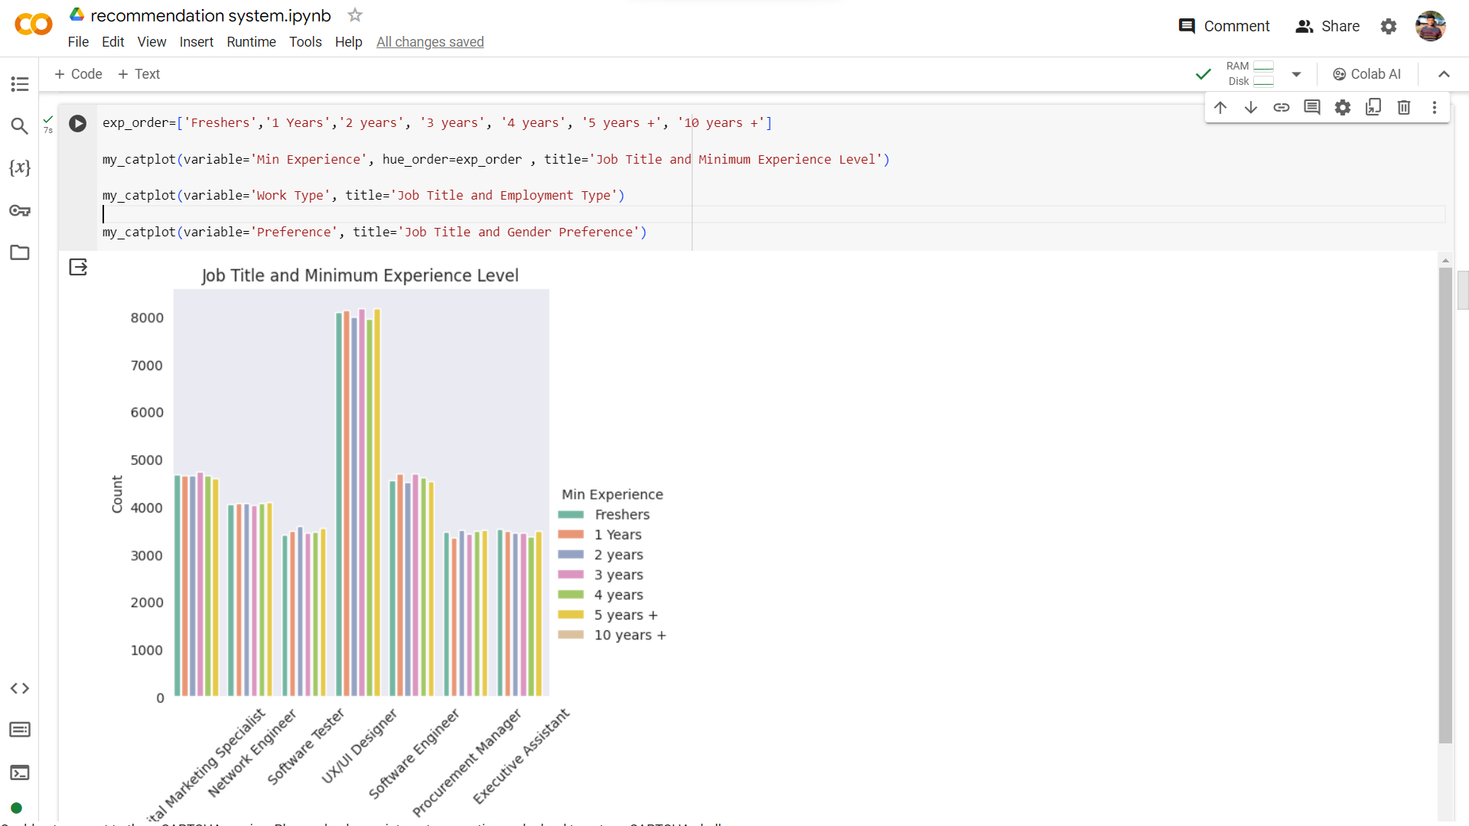
Exploratory Data Analysis(EDA)
I'll visualize real-time data based on candidate profiles, showcasing current market trends and skill demand. For instance, I've plotted graphs depicting:
Job Title vs. Minimum Experience Level
Job Title vs. Employment Type
Job Title vs. Gender Preference
Utilizing EDA:
Aids Recruiters in Market Trend Analysis
Empowers Candidates with Job Market Insights, Enhancing Talent Engagement
AI-driven Skill Recommendations:
Identifies In-demand Skills for Individuals on Unstop Platform (work in progress)
Analyzing Selection Rates:
Evaluates Selection Rates of Individuals with Similar Profiles Compared to Market Companies
Notes:
1. Recommendation system -
Collect Data From Both sides
Sentiment analysis on JOB Description.(through NLP)
#method 1 - content based filtering
Classifiy the job description and applicants data using: (DIVISION IN DIMENSIONS by Vectorisisations)
Word2Vec Algorithm: learning word embeddings, which are dense vector representations of words
TF - IDF : used to Iigh a keyword in any content and assign importance
Cosine Similarity : measures the similarity betIen two vectors by calculating the cosine of the angle betIen them.
#method 2
Collaborative filtering method.
Matrix Factorisation ( predict likelihood of users)
<improve data accuracy> - using Transfer learning (from LLMs)
it is called fine tuning
will enhance the efficiency of data drastically
LLM to be used 4J
2. EDA ( Exploratory data analysis )
Graph
trends analysis
This analysis will give us :-
Trends, Pattern,
If this data is shown Customers - (Job applicant and Hiring Manager)
This will help in Customer Engagement.
I will use seamless UI for this.
3. System Scales.( SCALING )
to Efficienty manage the increase in data I can distribute the task using MICROSERCICES.
Recommendation System || data analysis || Sentiment Analysis
Distributed scaling systems - Kaska ,Load Balancers. <-- system design
4. Deployment (Docker and Kubernetes) - so that application run in any environment

Slide 8
Future Projections for advanced recommendations.
Enhanced Personalization: I aim to delve deeper into user behavior and context to offer even more tailored recommendations, ensuring that each user's unique preferences are accurately captured and reflected in their suggestions.
Multi-modal Recommendations: By integrating different data modalities such as text, images, and videos, I seek to enrich the recommendation experience, providing users with a more diverse range of content suggestions that cater to their preferences and interests.
Real-time Recommendations: Our future projects include the implementation of real-time recommendation capabilities, enabling us to deliver timely suggestions to users based on their current browsing behavior and preferences.
Explainable Recommendations: I recognize the importance of transparency and user trust in recommendation systems. Hence, I plan to introduce features that provide insights into how recommendations are generated, empowering users to better understand and trust the system.
Integration of Reinforcement Learning: I aim to leverage reinforcement learning algorithms to optimize long-term user engagement by dynamically adapting recommendations based on user interactions and feedback, thereby enhancing user satisfaction.
Ethical and Fair Recommendations: Our commitment to ethical recommendation practices drives us to design recommendation systems that prioritize fairness, diversity, and transparency. I will continue to refine our algorithms to mitigate biases and ensure equitable outcomes for all users.
Collaborative Filtering with Graph Neural Networks: By harnessing the power of graph neural networks and collaborative filtering techniques, I aim to capture complex relationships and interactions between users and items, leading to more accurate and effective recommendations.

Slide 9



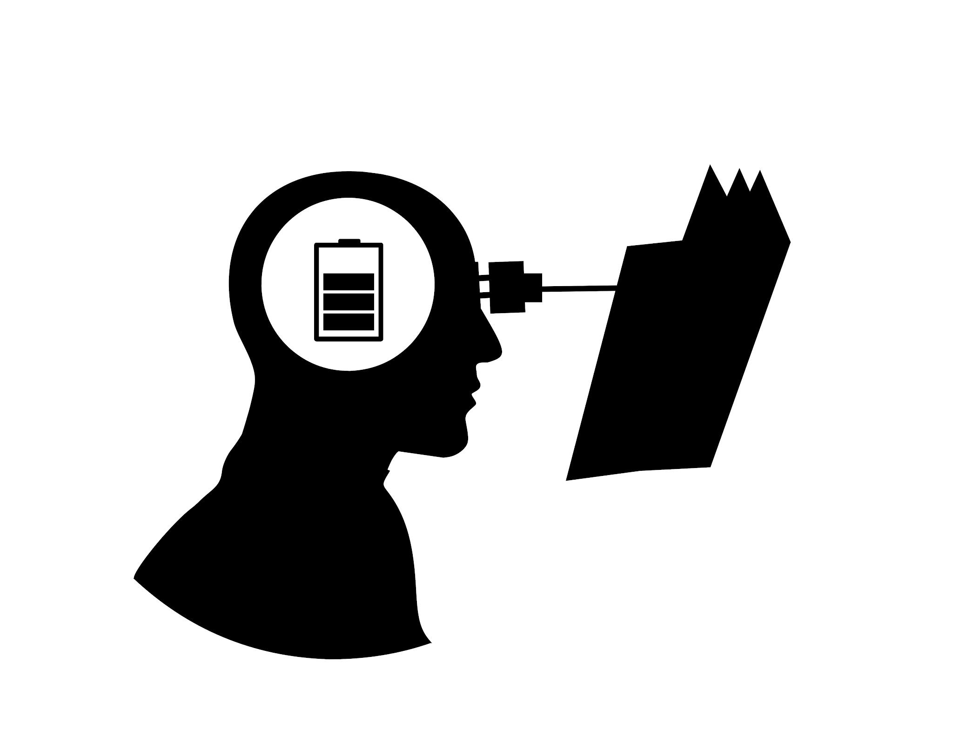
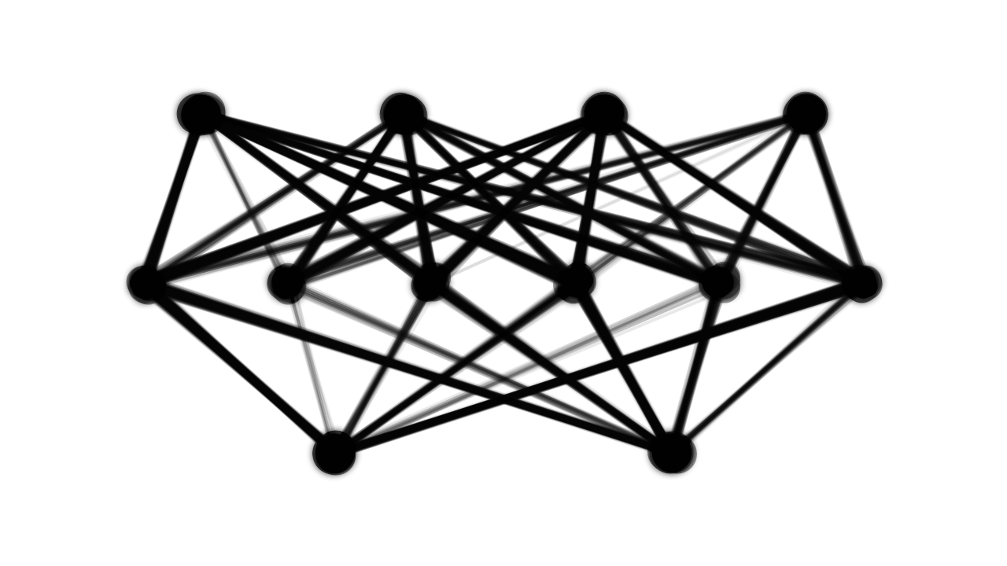

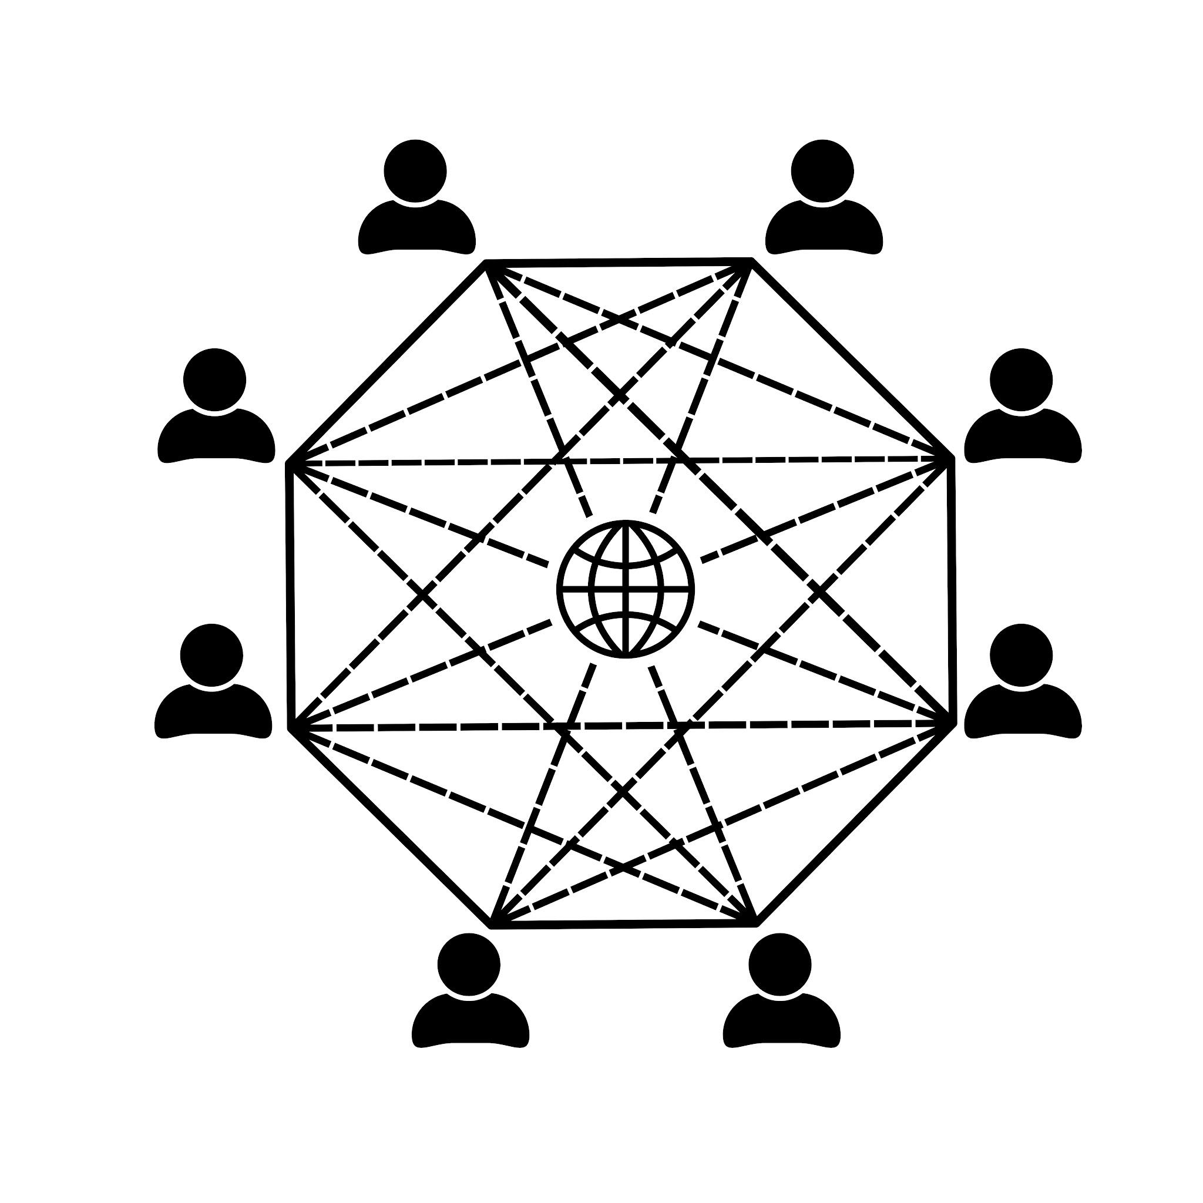
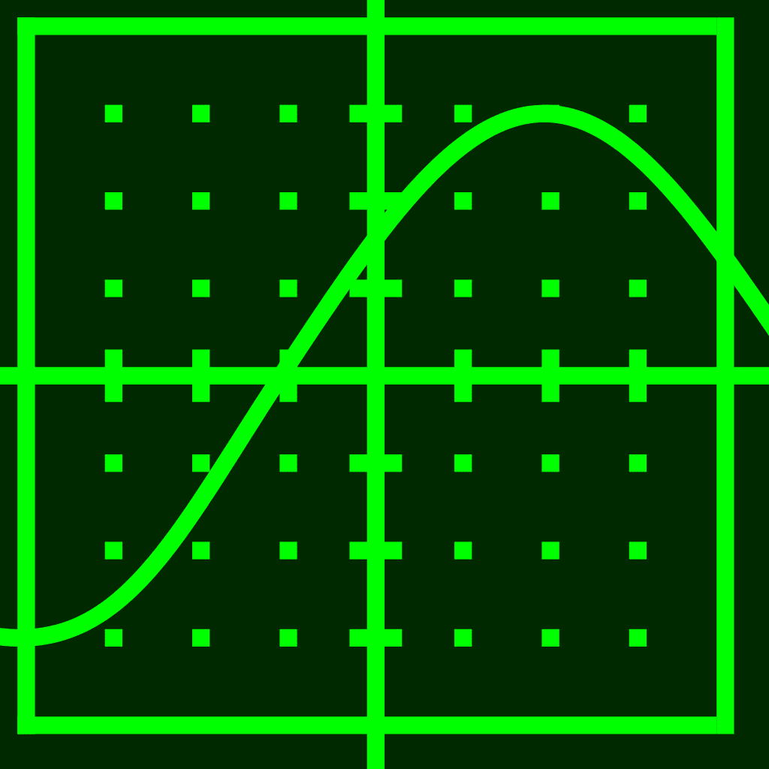








The process Diagram from previous round**
Showing this analysis
( which includes the selections of candidates in the specific roles based on their profiles )
to customers will enhance
Customer Engagement
Modeling /
Train Model
Applicant’s Data
Recruiter’s Demands
Evaluation
Data Collection
Fine-Tuning
(By LLM)
+ Seamless UI
BERT LLM +
I would ❤️ to build this
Data is not mixed
Current Model
Data Processing
Sentiment
Analysis
WORDS
Graphs
Trends /
Patterns
Correlation
Word2Vec Algorithm
FINAL MODEL
Exploratory Data Analysis (EDA)
As data grows big I need to Scale the data by using Microservices architectures, distributed system and computing process
NLP
Vectorised WORDS
These tools will help our product to run in any Environment
TF-IDF Algorithm
-IDF
Cosine Similarity Algorithm
Distributing Tasks
Classified Data
1. | Recommendation System
2. | Sentiment Analysis
3. | Data analysis
Kafka
Deployment
Load Balancer
Software Product

